Slide 1
Learning HTML CSS JavaScript Bootstrap with Python to Make Websites
Soumil Nitin Shah
Bachelor in Electronic Engineering
Master in Electrical Engineering
Master in Computer Engineeirng

Slide 2
What Is Html?
HTML is short for HyperText Markup Language. It’s code that we use to:
create documents that are stored on the World Wide Web and displayed in a browser.
provide a basic structure for our web page - the bones of the web page.
ensure proper loading of text and images for our browser to display.

Slide 3
When Do We Use Html?
Every web page you see on the World Wide Web is written using HTML code. Buttons, images, forms, sections of text - these are all elements that are created with HTML.
If we think of our web page as a human body, HTML is the bone structure. We can add skin and clothing to the body by using CSS, but only once we have that skeletal structure in place.

Slide 4

Software Requirement
Atom Software Link

Slide 5
HTML In Action

Slide 6
Tags
The essence of HTML programming is tags
A tag is a keyword enclosed by angle brackets ( Example: <I> )
There are opening and closing tags for many but not all tags; The affected text is between the two tags
The opening and closing tags use the same command except the closing tag contains and additional forward slash /
For example, the expression <B> Warning </B> would cause the word ‘Warning’ to appear in bold face on a Web page

Slide 7
Tags
<!-- opening tag --> <p> <!-- closing tag --> </p>

Slide 8
Parts of an HTML Element

Slide 9
Other Tag
<h1>My Day In The Garden</h1>. [Heading Tag] we have h1 to h6
<b>BOLD TAG </b>. [Bold Tag]
<i>TEXT</i> [italic TEXT tag]
<img src="" alt="">. [Image Tag]
<BR> Next Line
And so on ………
No Need to Remember all of this IDE Takes care of that lets us see how

Slide 10
Lets us see examples on H Tag with Bootstrap and CSS
Lets go to Atom

Slide 11
Lets us see Example on IMG Tag with Bootstrap and CSS
Lets go to Atom Editor

Slide 12
Lets us See examples on HREF using Bootstrap and CSS
Lest go to Atom Editor and see examples

Slide 13

Exercise 1 code the Following HTML Page
Remember we need IMG Tag and H Tag and P Tag

Slide 14
What are New Tag you Observed ?
<section> <h2>Information about me</h2> <p>I am coding out my first website. This is a paragraph that I would write with information about my interests.</p> <h3>My favorite websites</h3> <ul> <li><a href="www.google.com">Google</a></li> </ul> <h3>My favorite books</h3> <section> <h4>Non-Fiction</h4> <ol> <li>Eloquent Javascript</li> </ol> </section>

Slide 15
Example on Order and Unorder List
Back to Atom

Slide 16
Exercise
Try to add Hyper Link to order and unorder list

Slide 17
Some More Tag
<hr>. Horizontal Rule
<br>. Break

Slide 18
Part II. HTML
Forms

Slide 19
What is Form ?
A <form> is used to collect information from a user. For a <form> to work, it needs to send the data it collects somewhere to be processed or handled. Therefore, <form>often requires additional attributes:

Slide 20
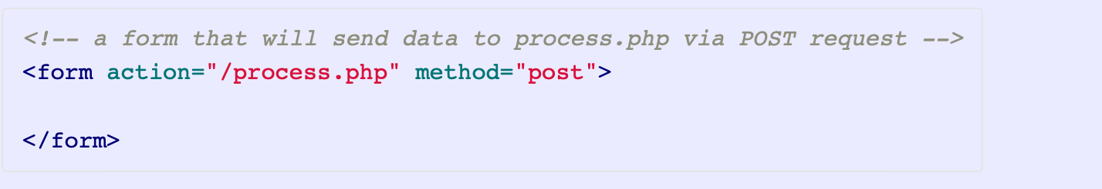
Form
action - the destination of the form data when the form is submitted
method - indicates whether the data should be processed using a GET or a POST type of request.

Slide 21
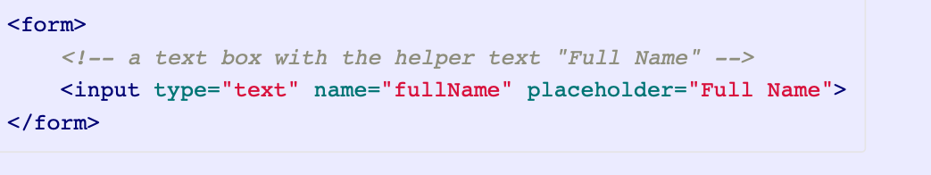
Input
<input> is the element used by a <form> to collect information.
An <input> element also usually has a name attribute that is used by databases to identify the field to which submitted data belongs.
The <input> element is very versatile: by specifying the type attribute, it can be rendered as a text field, calendar-style date picker, radio button, dropdown, and more. You can consult some external documentation to see a more complete list.

Slide 22
Lets us see Few Example
Back to Atom

Slide 23
Form Validation
Lets us go back to Atom and Learn about Form Validation

Slide 24
Drop Down and Radio Button

